Slide 1
Jukebox Project
By – Mihir Sharma

Slide 2
THE APPLICATION
My Jukebox application offers a music service to the user.
They can view songs and podcast information stored in SQL and play them using AudioInputStream.
They can also create a playlist and add songs/podcasts to it and listen to them.

Slide 3
Problem Statement
TASK 1: Add Song operations
Task 2: Add Podcast operations
Task 3: Add Playlist operations
Task 4: Add AudioStream utility

Slide 4
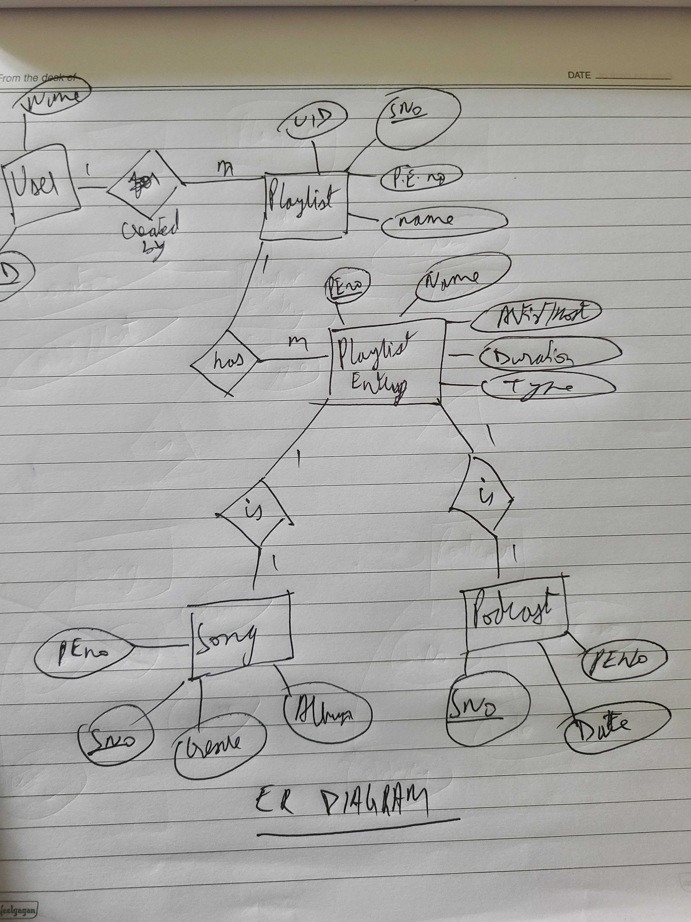
ER DIAGRAM

Slide 5
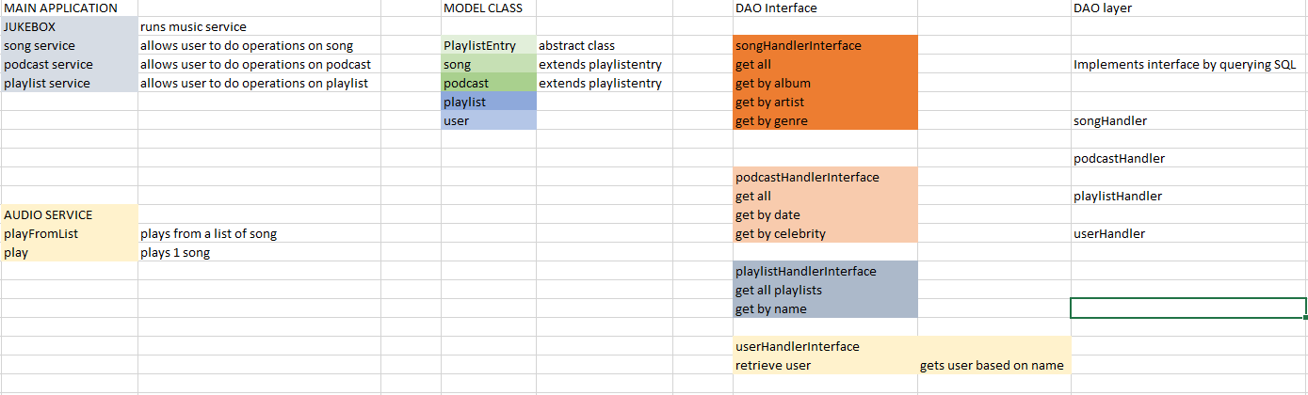
CLASS DIAGRAM

Slide 6
TOOLS USED
Object Oriented Programming
Exceptions and Junit
JDBC
Java 8
Javax libraries for playing audio

Slide 7
CODE DEMO
I will now Demo my project.

Slide 8
FUTURE UPGRADES
Add a GUI
Allow users to delete from their playlists and delete their accounts
Try to make the application more universal and not bound to 1 sql database/library

Slide 9
FINAL REMARKS
It was nice to apply my knowledge for this coding project. I plan on polishing it and improving it further.

